Slide 1
Lecture 13 Shortest Paths
Exercises ANS
Department of Computer Science
Hofstra University
Acknowledgement: Lecture slides based on UofW Course on Data Structures

Slide 2
Q. Dijkstra’s Algorithm
Exam question: Given this directed graph, run Dijkstra’s Algo to find shortest paths starting from source node A. Give the node visit order, and fill in this table of SN (Shortest Distance) and PN (Previous Node), crossing out old SD and PN as you find a shortcut path with smaller SD
Visit Order
Node | SD | PN
A
B
C
D
E
F
G
start
2
B
A
1
1
5
2
E
1
1
D
C
5
3
2
6
G
10
F

Slide 3
Q. Dijkstra’s Algorithm
0
∞
start
2
B
A
1
1
∞
2
5
E
∞
1
∞
1
D
C
5
3
∞
2
6
G
Node | SD | PN
A | ∞
B | ∞
C | ∞
D | ∞
E | ∞
F | ∞
G | ∞
∞
10
F
Visit Order
Notes:
Can print this on the worksheet

Slide 4
Q. Dijkstra’s Algorithm
0
∞
start
2
B
A
1
1
∞
2
5
E
1??
1
2??
1
D
C
5
3
∞
2
6
G
Node | SD | PN
A | 0 | /
B | ∞
C | 2 | A
D | 1 | A
E | ∞
F | ∞
G | ∞
∞
10
F
Visit Order
A

Slide 5
Q. Dijkstra’s Algorithm
0
6??
start
2
B
A
1
1
2??
2
5
E
1
1
2??
1
D
C
5
3
6??
2
6
G
Node | SD | PN
A | 0 | /
B | 6 | D
C | 2 | A
D | 1 | A
E | 2 | D
F | 7 | D
G | 6 | D
7??
10
F
Visit Order
A, D
We can choose to visit either C or E next, since they have equal smallest SD of 2 among all unvisited nodes. Let’s visit C in alphabetical order

Slide 6
Q. Dijkstra’s Algorithm
0
6??
start
2
B
A
1
1
2??
2
5
E
1
1
2
1
D
C
5
3
6??
2
6
G
Node | SD | PN
A | 0 | /
B | 6 | D
C | 2 | A
D | 1 | A
E | 2 | D
F | 7 4 | D C
G | 6 | D
4??
10
F
Visit Order
A, D, C

Slide 7
Q. Dijkstra’s Algorithm
0
3??
start
2
B
A
1
1
2
2
5
E
1
1
2
1
D
C
5
3
6??
2
6
G
Node | SD | PN
A | 0 | /
B | 6 3 | D E
C | 2 | A
D | 1 | A
E | 2 | D
F | 7 4 | D C
G | 6 | D
4??
10
F
Visit Order
A, D, C, E

Slide 8
Q. Dijkstra’s Algorithm
0
3
start
2
B
A
1
1
2
2
5
E
1
1
2
1
D
C
5
3
6??
2
6
G
Node | SD | PN
A | 0 | /
B | 6 3 | D E
C | 2 | A
D | 1 | A
E | 2 | D
F | 7 4 | D C
G | 6 | D
4??
10
F
Visit Order
A, D, C, E, B

Slide 9
Q. Dijkstra’s Algorithm
0
3
start
2
B
A
1
1
2
2
5
E
1
1
2
1
D
C
5
3
6??
2
6
G
Node | SD | PN
A | 0 | /
B | 6 3 | D E
C | 2 | A
D | 1 | A
E | 2 | D
F | 7 4 | D C
G | 6 | D
4
10
F
Visit Order
A, D, C, E, B, F

Slide 10
Q. Dijkstra’s Algorithm Final Answer
0
3
start
2
B
A
1
1
2
2
5
E
1
1
2
1
D
C
5
3
6
2
6
G
Node | SD | PN
A | 0 | /
B | 6 3 | D E
C | 2 | A
D | 1 | A
E | 2 | D
F | 7 4 | D C
G | 6 | D
4
10
F
Visit Order
A, D, C, E, B, F, G

Slide 11
Q. Dijkstra’s Algorithm (Source Node S)
ANS
ANS
A
A
2
Node | SD | PN
S | 0 | /
A
B
2
Node | SD | PN
S | 0 | /
A
B
S
S
1
3
4
4
B
B
ANS
ANS
A
A
Node | SD | PN
S | 0 | /
A
B
2
Node | SD | PN
S | 0 | /
A
B
2
S
S
1
1
4
4
B
B
11
Notes:
SD: Shortest Distance. PN: Previous Node

Slide 12
Q. Dijkstra’s Algorithm (Source Node S) Final Answer
ANS
ANS
A
A
2
Node | SD | PN
S | 0 | /
A | 2 | S
B | 4 3 | S A
2
Node | SD | PN
S | 0 | /
A | 2 | S
B | 4 | S
S
S
1
3
4
4
B
B
ANS
ANS
A
A
Node | SD | PN
S | 0 | /
A | 5 | B
B | 4 | S
2
Node | SD | PN
S | 0 | /
A | 2 | S
B | 4 | S
2
S
S
1
1
4
4
B
B
12
Notes:
SD: Shortest Distance. PN: Previous Node

Slide 13
Q. Dijkstra’s Algorithm (Source Node A, Undirected Graph)
3
B
D
3
1
A
1
2
Node | SD | PN
A
B
C
D
E
1
C
E
4
Visit Order
13
Notes:
David Kauchak
cs161
Summer 2009
Graphs: MSTs and Shortest Paths https://cs.pomona.edu/~dkauchak/classes/algorithms/

Slide 14
Initialize
∞
∞
3
B
D
3
0
1
A
1
2
Node | SD | PN
A | 0 | /
B | $$∞$$
C | $$∞$$
D | $$∞$$
E | $$∞$$
∞
1
C
E
∞
4
Visit Order
14

Slide 15
Visit Node A
3
∞
3
B
D
3
0
1
Node | SD | PN
A | 0 | /
B | 3 | A
C | 1 | A
D | $$∞$$
E | $$∞$$
A
1
2
1
1
C
E
∞
4
Visit Order
A
15

Slide 16
Visit Node C
2
∞
3
B
D
3
0
1
A
1
2
Node | SD | PN
A | 0 | /
B | 3 2 | A C
C | 1 | A
D | $$∞$$
E | 5 | C
1
1
C
E
5
4
Visit Order
A, C
16

Slide 17
Visit Node B
2
5
3
B
D
3
0
1
A
1
2
Node | SD | PN
A | 0 | /
B | 3 2 | A C
C | 1 | A
D | 5 | B
E | 5 3 | C B
1
1
C
E
3
4
Visit Order
A, C, B
17

Slide 18
Visit Node E
2
5
3
B
D
3
0
1
A
1
2
Node | SD | PN
A | 0 | /
B | 3 2 | A C
C | 1 | A
D | 5 | B
E | 5 3 | C B
1
1
C
E
3
4
Visit Order
A, C, B, E
Nothing changes
18

Slide 19
Visit Node D
2
5
3
B
D
3
0
1
A
1
2
Node | SD | PN
A | 0 | /
B | 3 2 | A C
C | 1 | A
D | 5 | B
E | 5 3 | C B
1
1
C
E
3
4
Visit Order
A, C, B, E, D
Nothing changes
19

Slide 20
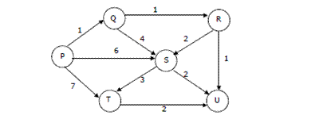
Q. Dijkstra’s Algorithm (Source Node P, Directed Graph)

Slide 21
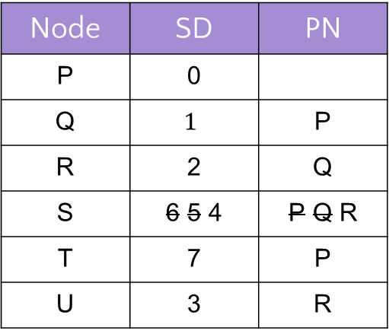
Q. Dijkstra’s Algorithm (Source Node P, Directed Graph) Final Answer
Visit order: P, Q, R, U, S, T
Node | SD | PN
P | 0
Q | $$1$$ | P
R | 2 | Q
S | 6 5 4 | P Q R
T | 7 | P
U | 3 | R

Slide 22
Q. Topological Sort
Consider this DAG, use Topological Sort to find Shortest Paths in DAG, considering all possible topological orders
Visit Order
0, 1, 4, 7, 5, 2, 3, 6
B
Node | SD | PN
A | 0 | /
B
C
D
E
10
-20
A
D
1
E
1
1
C

Slide 23
Q. Topological Sort Final Answer
Consider this DAG, use Topological Sort to find Shortest Paths in DAG, considering all possible topological orders
Visit Order
A, B, C, D, E
Visit Order
A, C, B, D, E
Node | SD | PN
A | 0
B | 10 | A
C | 1 | A
D | -10 | B
E | -9 | D
Node | SD | PN
A | 0
B | 10 | A
C | 1 | A
D | 2 -10 | C B
E | -9 | D
B
10
-20
A
D
1
E
1
1
C

